Slide 1
Convolutional Neural Network and its Variants
R. K. Agrawal
School of Computer and Systems Sciences
Jawaharlal Nehru University
NewDelhi-110067

Slide 2
Outline
Applications
Multilayer Perceptron
Shallow vs Deep
Building Blocks of CNN
Challenges

Slide 3

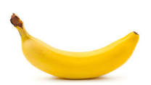

Slide 4



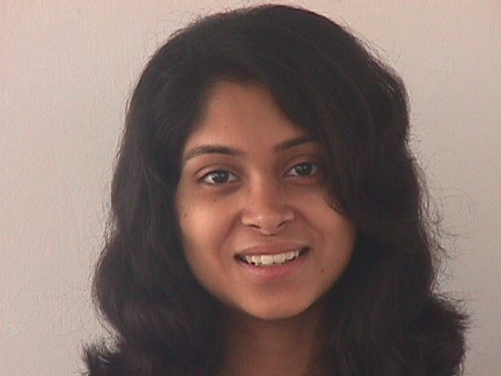
Face Recognition

Slide 5
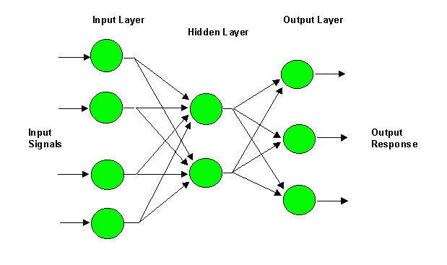
Multilayer Perceptron (MLP)
i
W_{ji}
j
W_{kj}
k

Slide 6
Multilayer Perceptron (MLP)
i
W_{ji}
j
W_{kj}
k
y_{j} = f(net_{j})
z_{k} = f(net_{k})

Slide 7
Multilayer Perceptron (MLP)
Δw_{kj} = ηδ_{k}y_{j} = η(t_{k} – z_{k}) f’ (net_{k})y_{j}

Slide 8
Multilayer Perceptron (MLP)

Slide 9
Universal Function Approximator
A one hidden layer FFNN with sufficiently large number of hidden nodes can approximate any function (Hornik, 1991)

Slide 10
Handwritten Character Recognition
Image size= 100 x 100
No. of nodes at hidden layer= 10⁶
No. of Classes =26
No. of Weights to be learned= 10¹⁰

Slide 11
Shallow vs Deep
Functions that can be compactly represented by a depth k architecture with fewer computational elements might require an larger number of computational elements to be represented by a depth k − 1 architecture.
Consequences are:
▪ Computational: We don’t need exponentially many elements in the layers
▪ Statistical: poor generalization may be expected when using an insufficiently deep architecture for representing some functions

Slide 12
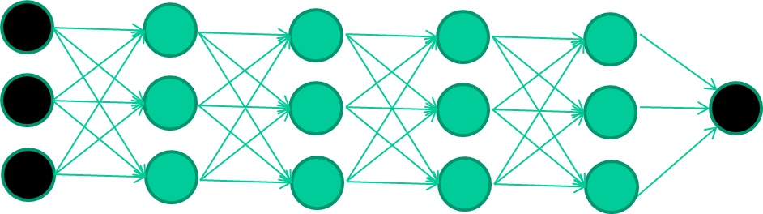
Deep Architecture

Slide 13
Deep Learning
Multilayer neural networks have been around for
25 years. What’s actually new?
We had good algorithms for learning the weights in networks with 1 or 2 hidden layer(s)
But these algorithms are not good at learning the weights for networks with more hidden layers

Slide 14


Slide 15
New way to train multi-layer NNs…

Slide 16
New way to train multi-layer NNs…
Train this layer first

Slide 17
New way to train multi-layer NNs…
Train this layer first
then this layer

Slide 18
New way to train multi-layer NNs…
Train this layer first
then this layer
then this layer

Slide 19
New way to train multi-layer NNs…
Train this layer first
then this layer
then this layer
then this layer

Slide 20
New way to train multi-layer NNs…
Train this layer first
then this layer
then this layer
then this layer
finally this layer

Slide 21
New way to train multi-layer NNs…
EACH of the (non-output) layers is trained to be an autoencoder
Basically, it is forced to learn good features that describe what comes from the previous layer

Slide 22
Autoencoder
x₁
x₂
x₃

Slide 23
Autoencoder
x₁
x₁
x₂
x₂
x₃
x₃

Slide 24
Autoencoder
x₁
x₁
x₂
x₂
x₃
x₃

Slide 25














What is Deep Learning
Data
Feature extraction
Prediction model
Conventional Machine Learning pipeline
Deep prediction model
Data
Feature extraction
Feature learning
Prediction
Deep Learning

Slide 26
Disadvantages of Neural Networks
The number of trainable parameters becomes extremely large
Little or no invariance to shifting, scaling, and other forms of distortion
The topology of the input data is completely ignored

Slide 27
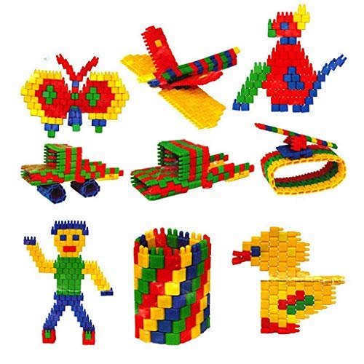
Building Blocks

Slide 28
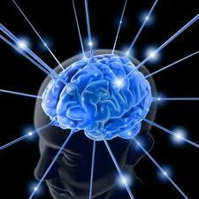
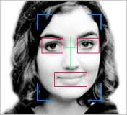
Learning by Composition? – A Face Recognition Analogy
Face or not ?
……
Lines, circles, squares
Brain Learning
Image pixels

Slide 29
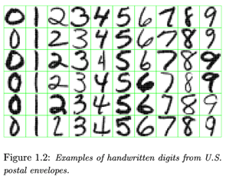
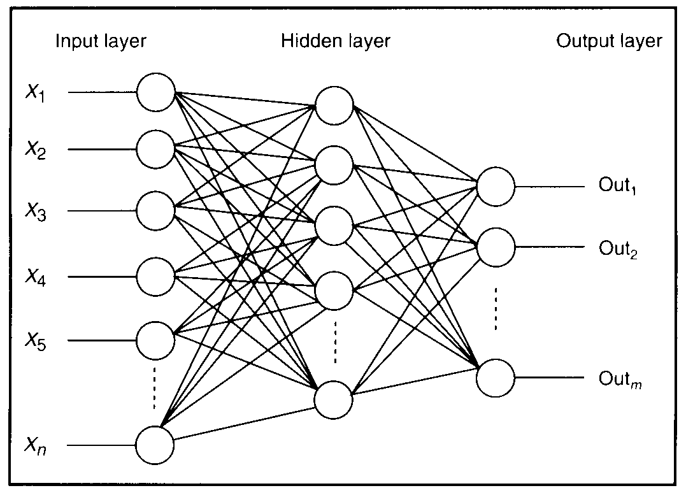
Feature detectors

Slide 30
vertical lines
1
63

Slide 31
Horizontal lines
1
63

Slide 32
Small circles
1
63

Slide 33
Small circles
1
But what about position invariance ???
our example unit detectors were tied to
specific parts of the image
63

Slide 34

Edge Operators
Good Localization
Gradient:
Noise Sensitive Poor Detection
Roberts (2 x 2):
Sobel (3 x 3):
0 | 1
-1 | 0
1 | 0
0 | -1
-1 | 0 | 1
-1 | 0 | 1
-1 | 0 | 1
1 | 1 | 1
0 | 0 | 0
-1 | -1 | 1
Sobel (5 x 5):
-1 | -2 | 0 | 2 | 1
-2 | -3 | 0 | 3 | 2
-3 | -5 | 0 | 5 | 3
-2 | -3 | 0 | 3 | 2
-1 | -2 | 0 | 2 | 1
1 | 2 | 3 | 2 | 1
2 | 3 | 5 | 3 | 2
0 | 0 | 0 | 0 | 0
-2 | -3 | -5 | -3 | -2
-1 | -2 | -3 | -2 | -1
Poor Localization Less Noise Sensitive Good Detection

Slide 35
Original Image
Horizontal Edge
Vertical Edge

Slide 36
Original Image
Horizontal Edge
Vertical Edge

Slide 37
Sobel Edges

Slide 38
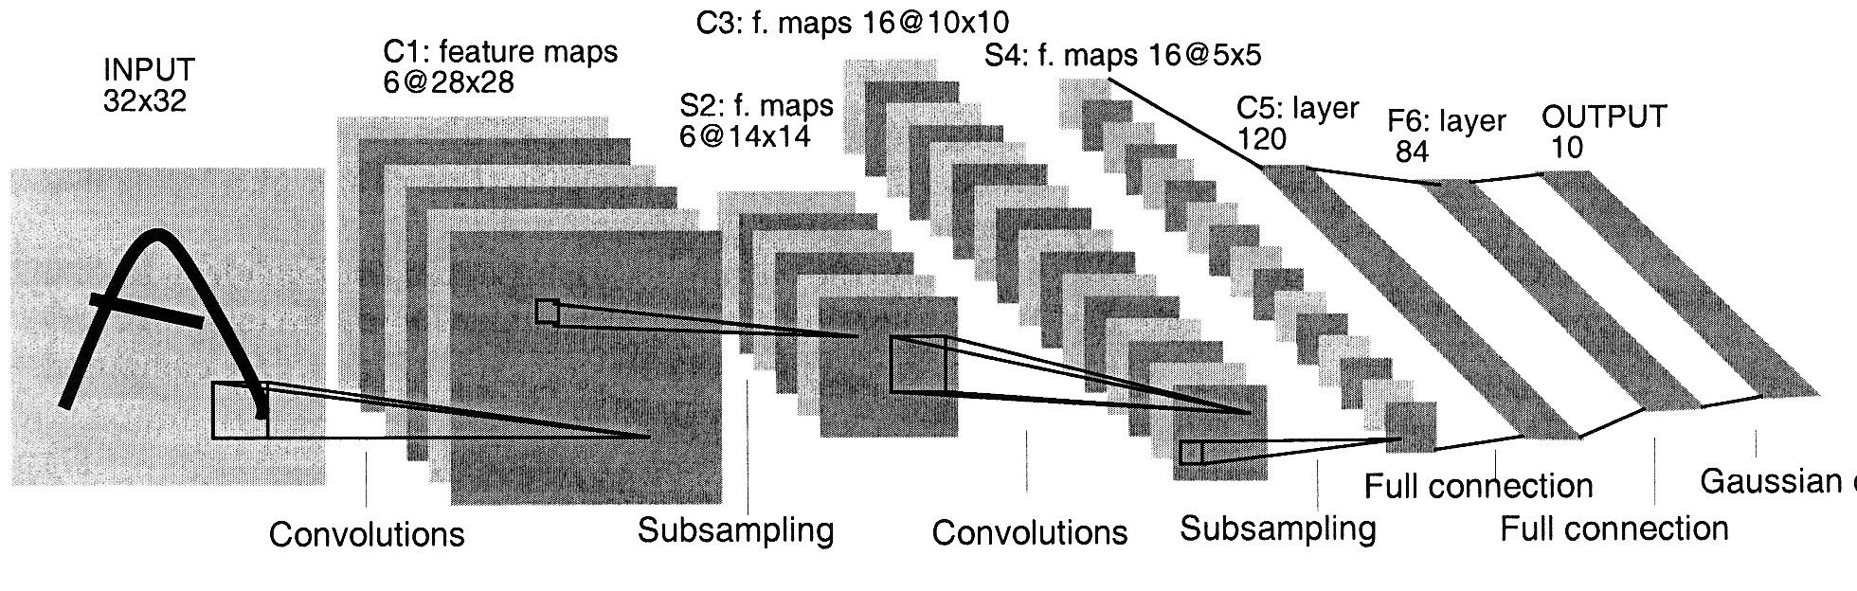
Convolutional Neural Network (CNN)
5 x 5 x 16
=(5-5)/1 +1 =1
=(16-16)/1 +1 =1

Slide 39
Convolution
These are the network parameters to be learned.
1 | -1 | -1
-1 | 1 | -1
-1 | -1 | 1
1 | 0 | 0 | 0 | 0 | 1
0 | 1 | 0 | 0 | 1 | 0
0 | 0 | 1 | 1 | 0 | 0
1 | 0 | 0 | 0 | 1 | 0
0 | 1 | 0 | 0 | 1 | 0
0 | 0 | 1 | 0 | 1 | 0
Filter 1
-1 | 1 | -1
-1 | 1 | -1
-1 | 1 | -1
Filter 2
……
6 x 6 image
Each filter detects a small pattern (3 x 3).

Slide 40
Convolution
1 | -1 | -1
-1 | 1 | -1
-1 | -1 | 1
Filter 1
stride=1
1 | 0 | 0 | 0 | 0 | 1
0 | 1 | 0 | 0 | 1 | 0
0 | 0 | 1 | 1 | 0 | 0
1 | 0 | 0 | 0 | 1 | 0
0 | 1 | 0 | 0 | 1 | 0
0 | 0 | 1 | 0 | 1 | 0
Dot
product
3
-1
6 x 6 image

Slide 41
Convolution
1 | -1 | -1
-1 | 1 | -1
-1 | -1 | 1
Filter 1
If stride=2
F(t) = max(0,t)= max(0,1)=1
1 | 0 | 0 | 0 | 0 | 1
0 | 1 | 0 | 0 | 1 | 0
0 | 0 | 1 | 1 | 0 | 0
1 | 0 | 0 | 0 | 1 | 0
0 | 1 | 0 | 0 | 1 | 0
0 | 0 | 1 | 0 | 1 | 0
3
-3
6 x 6 image

Slide 42
Convolution
1 | -1 | -1
-1 | 1 | -1
-1 | -1 | 1
Filter 1
stride=1
1 | 0 | 0 | 0 | 0 | 1
0 | 1 | 0 | 0 | 1 | 0
0 | 0 | 1 | 1 | 0 | 0
1 | 0 | 0 | 0 | 1 | 0
0 | 1 | 0 | 0 | 1 | 0
0 | 0 | 1 | 0 | 1 | 0
3
-1
-3
-1
-3
1
0
-3
-3
-3
0
1
3
-2
-2
-1
6 x 6 image

Slide 43
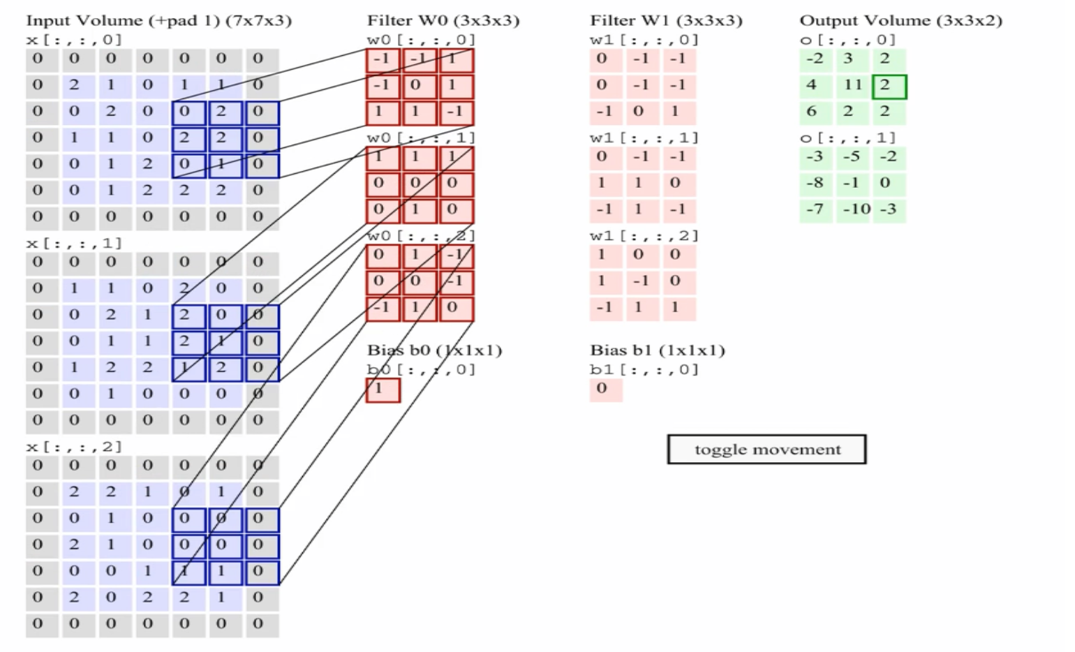
Multiple Convolutions
Animation: Andrej Karpathy http://cs231n.github.io/convolutional-networks/

Slide 44
Convolution
-1 | 1 | -1
-1 | 1 | -1
-1 | 1 | -1
Filter 2
stride=1
Repeat this for each filter
1 | 0 | 0 | 0 | 0 | 1
0 | 1 | 0 | 0 | 1 | 0
0 | 0 | 1 | 1 | 0 | 0
1 | 0 | 0 | 0 | 1 | 0
0 | 1 | 0 | 0 | 1 | 0
0 | 0 | 1 | 0 | 1 | 0
3
-1
-3
-1
-1
-1
-1
-1
-3
1
0
-3
-1
-1
-2
1
Feature
Map
-3
-3
0
1
-1
-1
-2
1
3
-2
-2
-1
6 x 6 image
-1
0
-4
3
Two 4 x 4 images
Forming 2 x 4 x 4 matrix

Slide 45
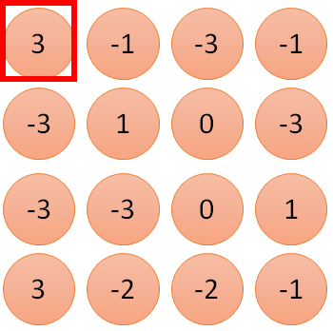
1 | -1 | -1
-1 | 1 | -1
-1 | -1 | 1
1
1
Filter 1
2
0
3
0
3
4:
0
1 | 0 | 0 | 0 | 0 | 1
0 | 1 | 0 | 0 | 1 | 0
0 | 0 | 1 | 1 | 0 | 0
1 | 0 | 0 | 0 | 1 | 0
0 | 1 | 0 | 0 | 1 | 0
0 | 0 | 1 | 0 | 1 | 0
…
0
8
1
9
0
10:
0
…
13
0
6 x 6 image
14
0
fewer parameters!
15
Only connect to 9 inputs, not fully connected
1
16
1
…

Slide 46
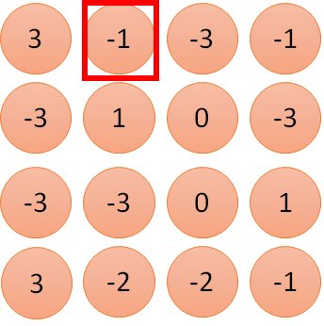
1 | -1 | -1
-1 | 1 | -1
-1 | -1 | 1
1:
1
Filter 1
2:
0
3:
0
3
4:
0
1 | 0 | 0 | 0 | 0 | 1
0 | 1 | 0 | 0 | 1 | 0
0 | 0 | 1 | 1 | 0 | 0
1 | 0 | 0 | 0 | 1 | 0
0 | 1 | 0 | 0 | 1 | 0
0 | 0 | 1 | 0 | 1 | 0
…
7:
0
8:
1
-1
9:
0
10:
0
…
13:
0
6 x 6 image
14:
0
Fewer parameters
15:
1
16:
1
Shared weights
Even fewer parameters
…

Slide 47
Convolutions: More detail
N
 |  |  | F
 | F
Output size: (N - F) / stride + 1
e.g. N = 6, F = 3:
stride 1 => (6 - 3)/1 + 1 = 4
stride 2 => (6 - 3)/2 + 1 = 2.5

Slide 48
Convolutions: More detail
In practice: Common to zero pad the border
0 | 0 | 0 | 0 | 0 | 0 | 0 | 0 | 0
0 |  |  |  |  |  |  |  | 0
0 |  |  |  |  |  |  |  | 0
0 |  |  |  |  |  |  |  | 0
0 |  |  |  |  |  |  |  | 0
0 |  |  |  |  |  |  |  | 0
0 |  |  |  |  |  |  |  | 0
0 |  |  |  |  |  |  |  | 0
0 | 0 | 0 | 0 | 0 | 0 | 0 | 0 | 0
Output size: (W−F+2P)/S +1
Input volume: 32x32x3
10 5x5 filters with stride 1, pad 2 Output volume size:
(32+2*2-5)/1+1 = 32 spatially,
so 32x32x10

Slide 49
Convolutions: More detail
In practice: Common to zero pad the border
0 | 0 | 0 | 0 | 0 | 0 | 0 | 0 | 0
0 |  |  |  |  |  |  |  | 0
0 |  |  |  |  |  |  |  | 0
0 |  |  |  |  |  |  |  | 0
0 |  |  |  |  |  |  |  | 0
0 |  |  |  |  |  |  |  | 0
0 |  |  |  |  |  |  |  | 0
0 |  |  |  |  |  |  |  | 0
0 | 0 | 0 | 0 | 0 | 0 | 0 | 0 | 0
Output size: (W−F+2P)/S +1
Input volume: 32x32x3
10 5x5 filters with stride 1, pad 2
No. of parameters in this layer?
Each filter has 5*5*3 + 1 = 76 params => 76*10 = 760

Slide 50
Spatial arrangement
Three hyperparameters control the size of the output volume
– Depth: no of filters, each learning to look for something different in the input.
– the stride with which we slide the filter.
– pad the input volume with zeros around the border.

Slide 51
Spatial arrangement
We compute the spatial size of the output volume as a function of
– the input volume size (W)
– the receptive field size of the Conv Layer neurons (F)
– the stride with which they are applied (S)
– the amount of zero padding used (P) on the border.
• The number of neurons that “fit” is given by (W−F+2P)/(S+1)
– For a 7x7 input and a 3x3 filter with stride 1 and pad 0 we would get a 5x5 output.
– With stride 2 we would get a 3x3 output.

Slide 52
Max Pooling
1 | -1 | -1
-1 | 1 | -1
-1 | -1 | 1
-1 | 1 | -1
-1 | 1 | -1
-1 | 1 | -1
Filter 1
Filter 2
3
-1
-3
-1
-1
-1
-1
-1
-3
1
0
-3
-1
-1
-2
1
-3
-3
0
1
-1
-1
-2
1
3
-2
-2
-1
-1
0
-4
3

Slide 53


Why Pooling?
Subsampling pixels will not change the object
bird
bird
Subsampling
We can subsample the pixels to make image smaller
Fewer parameters to characterize the image

Slide 54
Why Pooling?
bird
bird
Subsampling
Invariance to small transformations
Larger receptive fields (neurons see more of input)

Slide 55
Pooling Layer
Insertion of pooling layer:
reduce the spatial size of the representation
reduce the amount of parameters and computation in the network, and hence also control overfitting.
The Pooling Layer operates independently on every depth slice of the input and resizes it spatially, using the MAX operation.
The most common form is a pooling layer with filters of size 2x2 applied with a stride of 2 -- downsamples every depth slice in the input by 2 along both width and height,
The depth dimension remains unchanged.

Slide 56
General Pooling Layer
Other pooling functions:
Average pooling
L2- norm pooling

Slide 57
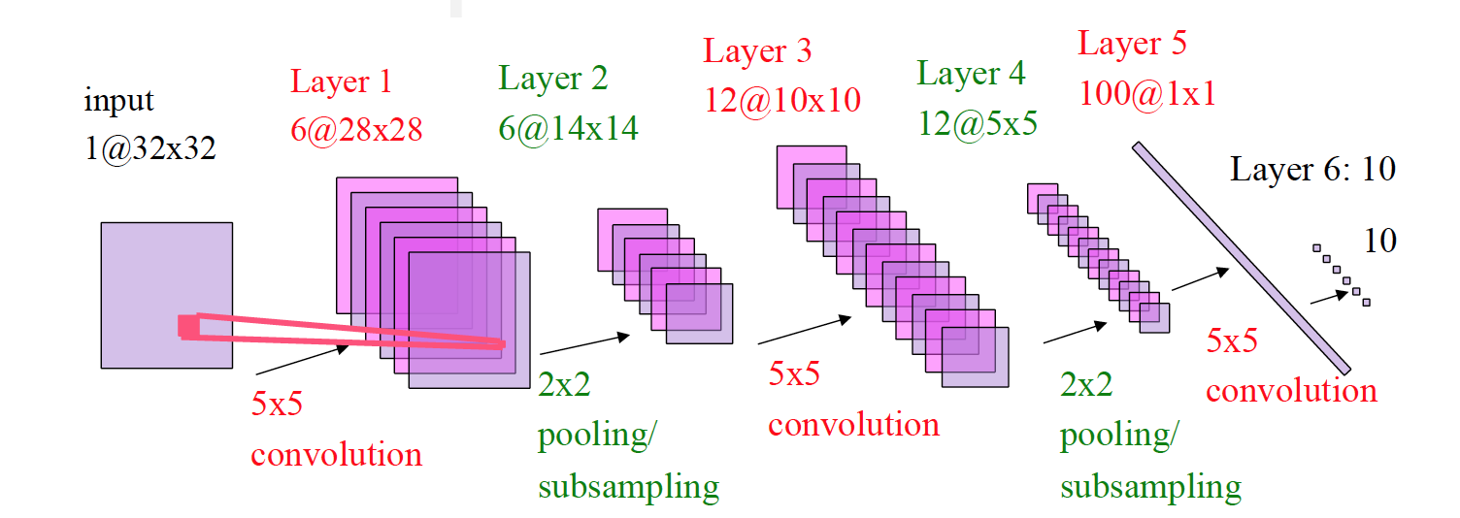
Convolutional Neural Network (CNN) [LeCun 1998]
=(25*6 +6) + (150*12+12) + (300*100+100) + (100*10+10)

Slide 58
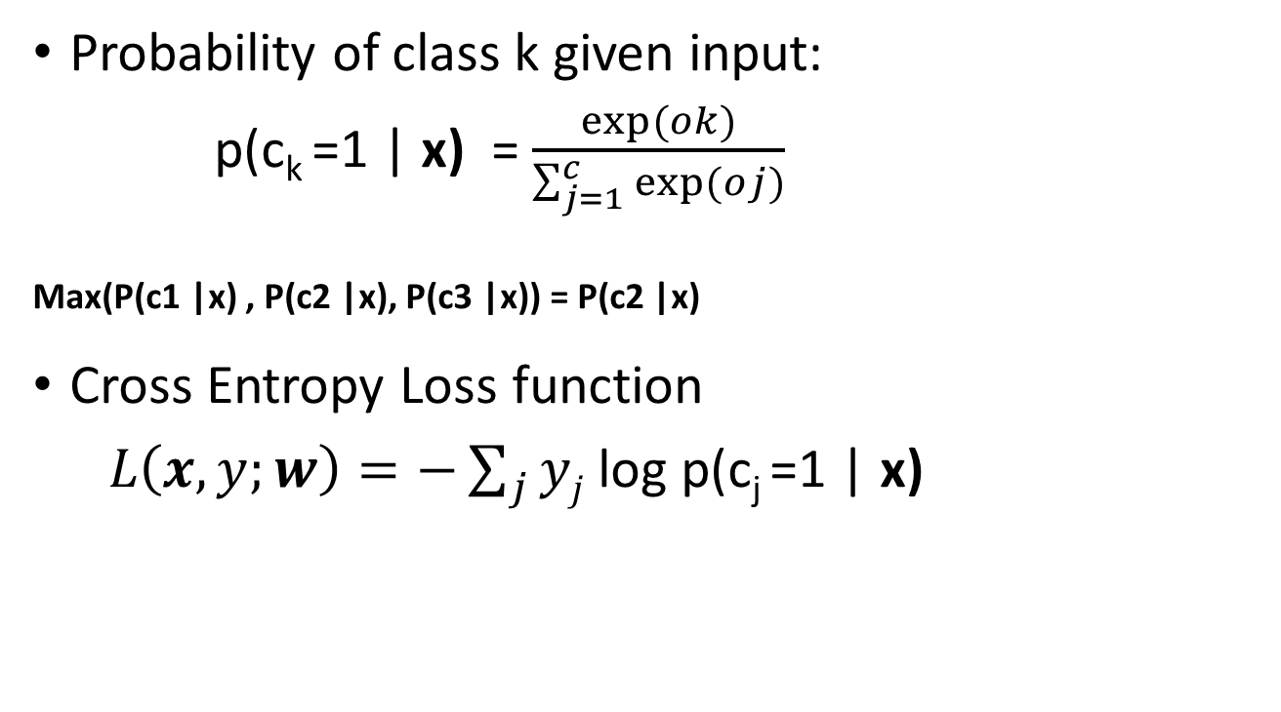
Softmax Layer and loss function
Probability of class k given input:
p(c_{k} =1 | x) = $\frac{exp⁡(ok)}{\sum_{j=1}^{c}{exp⁡(oj)}}$
Max(P(c1 |x) , P(c2 |x), P(c3 |x)) = P(c2 |x)
Cross Entropy Loss function
$L\left(x, y;w\right)=−\sum_{j}{yj}$ log p(c_{j} =1 | x)

Slide 59
A CNN compresses a fully connected network in two ways
Reducing number of connections
Shared weights on the edges
Max pooling further reduces the complexity

Slide 60

Going deep
object models
object parts
(combination
of edges)
edges
Training set: Aligned
images of faces.
pixels
[Honglak Lee]

Slide 61
Convolutional Neural Network (CNN)
Compared to standard feedforward neural networks with similarly-sized layers,
▪ CNNs have much fewer connections and parameters
▪ and so they are easier to train,
▪ while their theoretically-best performance is likely to be only slightly worse.

Slide 62
Problem of Fitting
Too many parameters = overfitting
Not enough parameters = underfitting
More data = less chance to overfit
How do we know what is required?

Slide 63
Regularization
Attempt to guide solution to not overfit
But still give freedom with many parameters

Slide 64
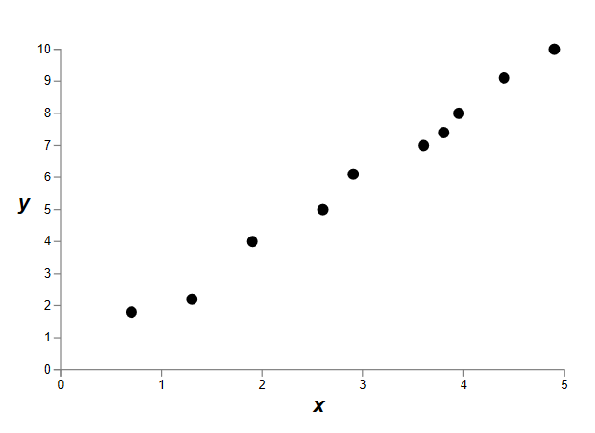
Data fitting problem

Slide 65
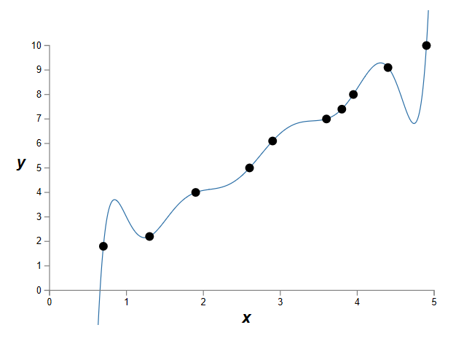
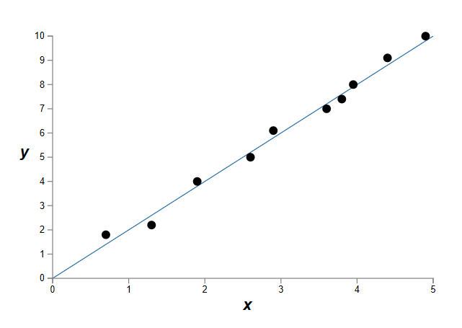
Which is better?
9th order polynomial
1st order polynomial
Notes:
How do we know a priori how many parameters we need?
Cross-validation is one way.

Slide 66
Regularization
Attempt to guide solution to not overfit
But still give freedom with many parameters
Idea: Penalize the use of parameters to prefer small weights.

Slide 67
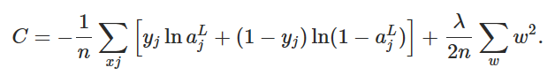
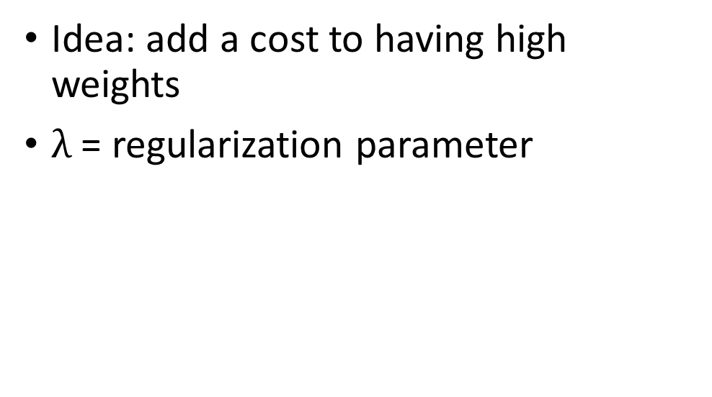
Regularization
Idea: add a cost to having high weights
$λ$ = regularization parameter
Normal cross-entropy loss (binary classes)
Regularization term
[
Notes:
n is size of training data
Intuitively, the effect of regularization is to make it so the network prefers to learn small weights, all other things being equal. Large weights will only be allowed if they considerably improve the first part of the cost function. Put another way, regularization can be viewed as a way of compromising between finding small weights and minimizing the original cost function.

Slide 68
Both can describe the data…
…but one is simpler.
Occam’s razor:
“Among competing hypotheses, the one with the fewest assumptions should be selected”
Large weights cause large changes in behaviour in response to small changes in the input.
Simpler models (or smaller changes) are more robust to noise.
Notes:
Why does this help reduce overfitting?

Slide 69
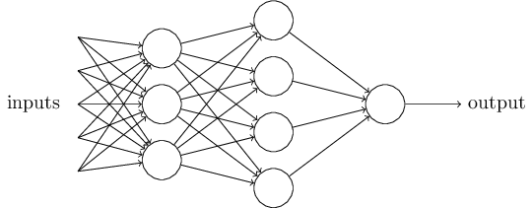
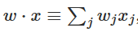
Regularization: Dropout
Our networks typically start with random weights.
Every time we train = slightly different outcome.
Why random weights?
If weights are all equal, response across filters will be equivalent.
Network doesn’t train.
Notes:
http://stackoverflow.com/questions/20027598/why-should-weights-of-neural-networks-be-initialized-to-random-numbers

Slide 70
Regularization
Our networks typically start with random weights.
Every time we train = slightly different outcome.
Why not train 5 different networks with random starts and vote on their outcome?
Works fine!
Helps generalization because error is averaged.
Notes:
Any problem here?
But, kind of slow?

Slide 71
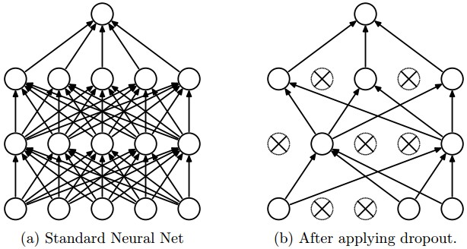
Regularization: Dropout

Slide 72
Regularization: Dropout
At each mini-batch:
Randomly select a subset of neurons and ignore them.
individual nodes are either dropped out of the net with probability 1-p; incoming and outgoing edges to a dropped-out node are also removed. On test: half weights outgoing to compensate for training on half neurons.
Effect:
Neurons become less dependent on output of connected neurons.
Forces network to learn more robust features that are useful to more subsets of neurons.
Like averaging over many different trained networks with different random initializations.
Except cheaper to train.

Slide 73
Many forms of ‘regularization’
Adding more data is a kind of regularization
Pooling is a kind of regularization
Data augmentation is a kind of regularization

Slide 74
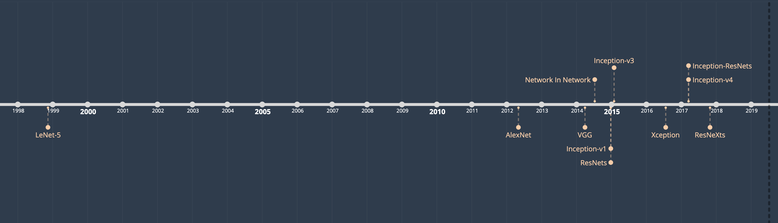
Comparison of CNN Architectures

Slide 75
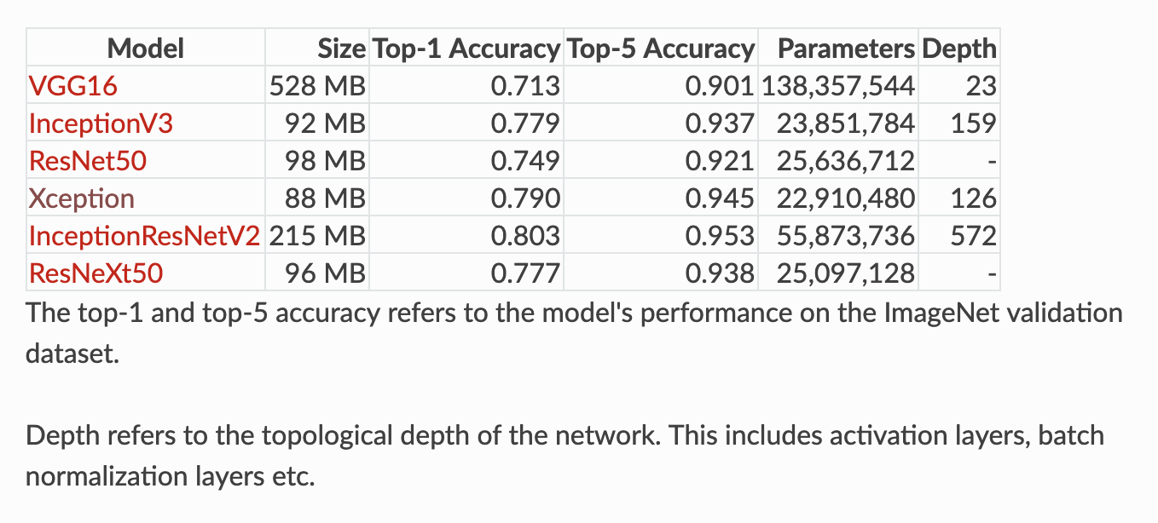
Comparison of CNN Architectures

Slide 76
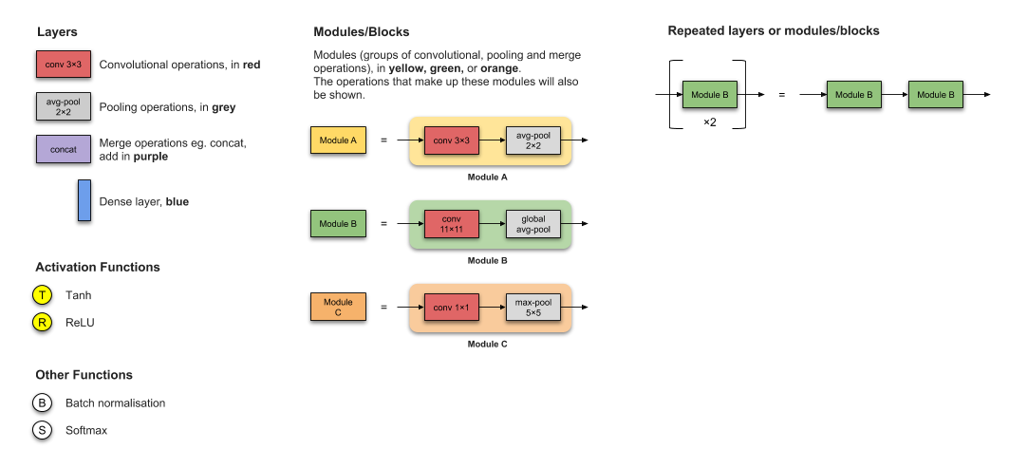
Legend

Slide 77
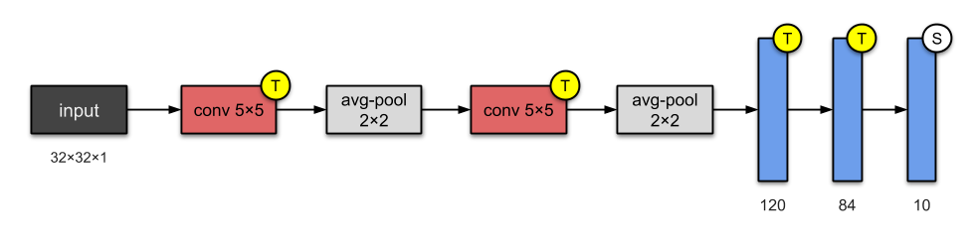
LeNet5 (1998)
LeNet-5 is one of the simplest architectures.
It has 2 convolutional and 3 fully-connected layers
This architecture has about 60,000 parameters.

Slide 78
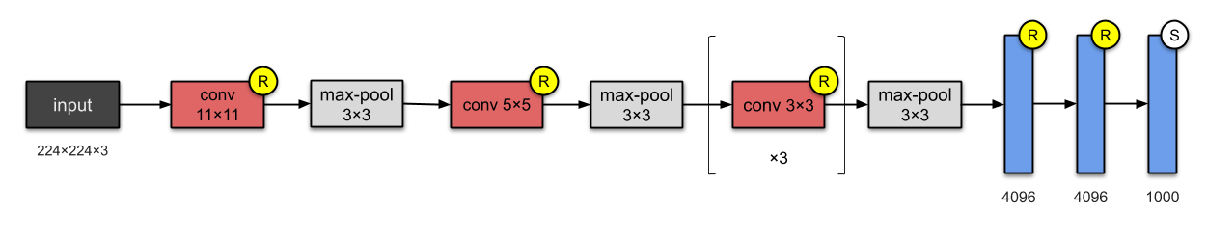
AlexNet (2012)

Slide 79
AlexNet (2012)
AlexNet has 8 layers — 5 convolutional and 3 fully-connected.
With 60M parameters
Novelity
First to implement Rectified Linear Units (ReLUs) as activation functions.
Dropout.

Slide 80
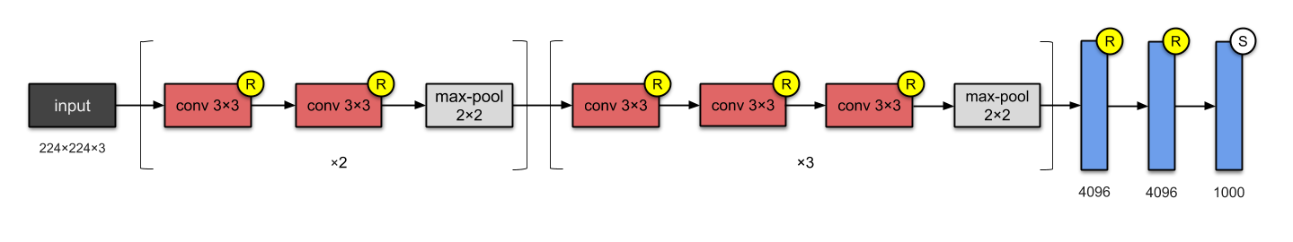
VGG-16 (2014)

Slide 81
VGG-16 (2014)
Deeper CNNs
Visual Geometry Group (VGG) suggested the VGG-16 which has 13 convolutional and 3 fully-connected layers.
This network stacks more layers onto AlexNet, and use smaller size filters (2×2 and 3×3).
It consists of 138M parameters and uses about 500MB.
They also designed a deeper variant, VGG-19.
Novelity
Designing of deeper networks (roughly twice as deep as AlexNet).

Slide 82
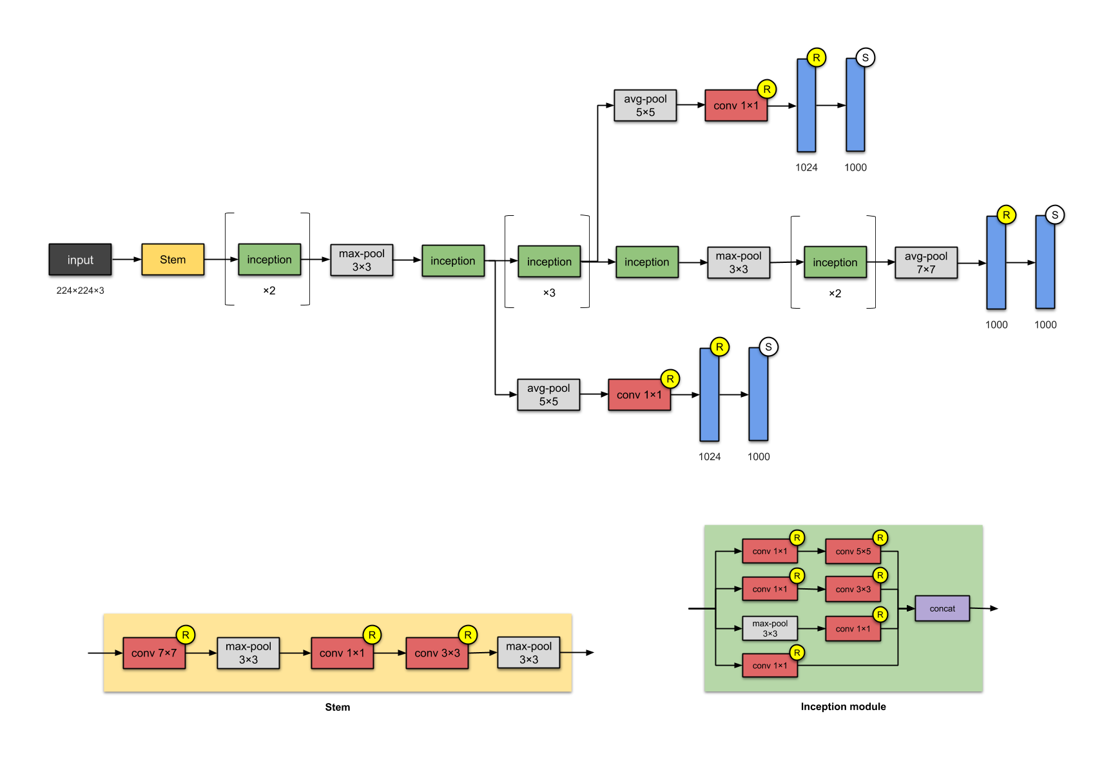
Inception-v1 (2014)

Slide 83
Inception-v1 (2014)
This 22-layer architecture with 5M parameters
Here, the Network In Network approach is heavily used. This is done by means of ‘Inception modules’. The design of the architecture of an Inception module is a product of research on approximating sparse structures.
Each module presents 3 ideas:
Having parallel towers of convolutions with different filters, followed by concatenation, captures different features at 1×1, 3×3 and 5×5, thereby ‘clustering’ them.
1×1 convolutions are used for dimensionality reduction to remove computational bottlenecks.
Due to the activation function from 1×1 convolution, its addition also adds nonlinearity.
Novelity
Building networks using modules/blocks. Instead of stacking convolutional layers, stack modules or blocks, within which are convolutional layers are used.

Slide 84
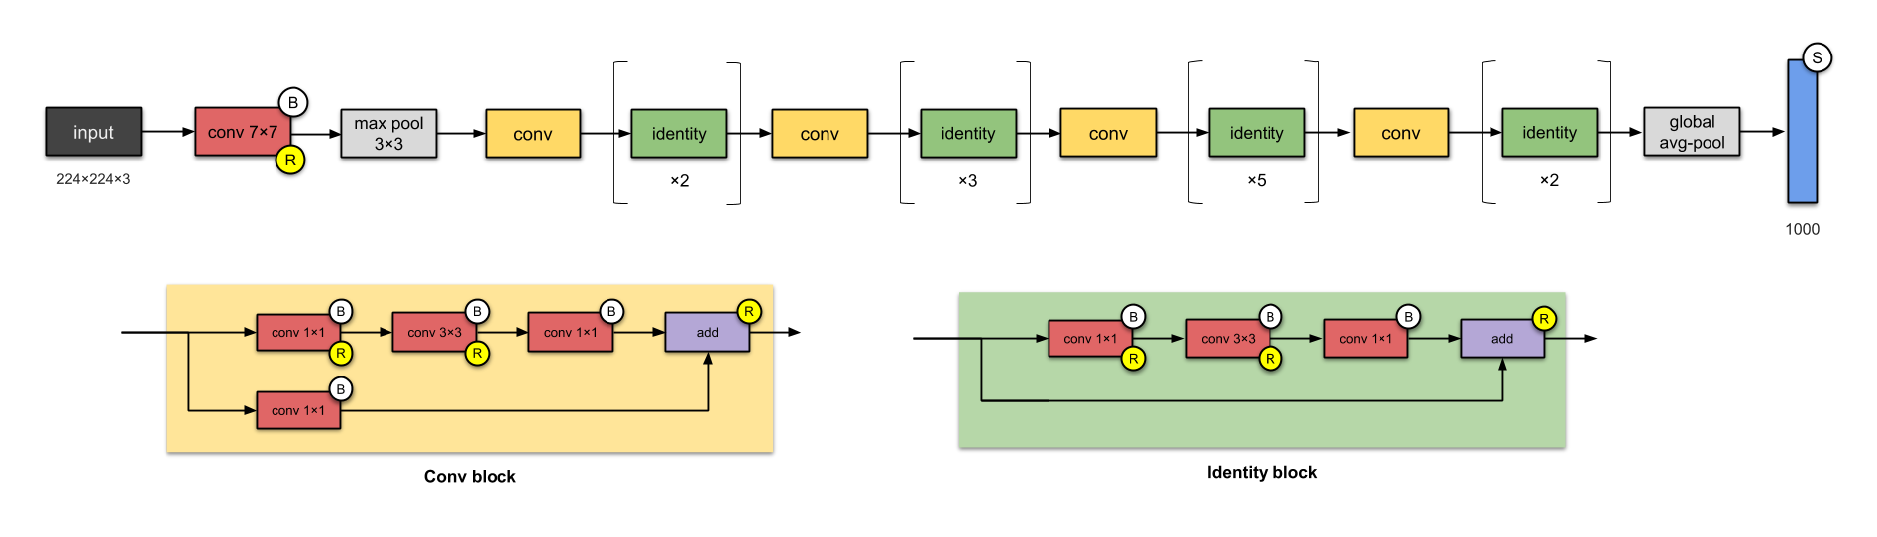
ResNet50 (2015)

Slide 85
ResNet50 (2015)
Increasing number of layers in the design, and achieving better performance.
But “with the network depth increasing, accuracy gets saturated and then degrades rapidly.”
Used skip connections while building deeper models.
ResNet utilized batch normalization.
ResNet-50 has 26M parameters.
The basic building block for ResNets are the conv and identity blocks.

Slide 86
ResNet50 (2015)
Novelity
Popularised skip connections (they weren’t the first to use skip connections).
Designing even deeper CNNs (up to 152 layers) without compromising model’s generalisation power
Among the first to use batch normalisation.

Slide 87
CNN applications
Transfer learning
Fine-tuning the CNN
Keep some early layers
Early layers contain more generic features, edges, color blobs
Common to many visual tasks
Fine-tune the later layers
More specific to the details of the class
CNN as feature extractor
Remove the last fully connected layer
A kind of descriptor or CNN codes for the image
AlexNet gives a 4096 Dim descriptor
Notes:
http://cs231n.github.io/neural-networks-1/

Slide 88
Challenges
How to decide the number of hidden layers and nodes?
Choosing suitable deep learning architecture for a given data
Choosing suitable error and activation function

Slide 89
Challenges
Deep Learning from high volume of data
Deep Learning for high variety of data
Deep Learning with fast moving and steaming data
Scalability of the model
Distributed computing of data

Slide 90
References
Neural Networks for Pattern Recognition”, Bishop, C.M., 1996
Deep Belief Nets, 2007 NIPS tutorial , G . Hinton
Slides adapted from Andrew NG and G . Hinton
https://www.macs.hw.ac.uk/~dwcorne/
https://cs.uwaterloo.ca/~mli/
cs231n.stanford.edu/slides/2017/
Deep learning applications and challenges in big data analyticsMM Najafabadi, F Villanustre, TM Khoshgoftaar, N Seliya, R Wald, Journal of Big Data 2 (1), 1, 2015
Xue-Wen-Chen and Xiaotong Lin, “big data deep learning: challenges and perspectives”, IEEE, 2, 514-525, 2014
https://machinelearningmastery.com/inspirational-applications-deep-learning/
https://data-flair.training/blogs/applications-of-deep-learning-with-python/

Slide 91
Thanks

Slide 92
Parameter sharing
Parameter sharing controls the number of parameters.
If there are 55*55*96 = 290,400 neurons in the first Conv Layer, and each has 11*11*3 = 363 weights and 1 bias. Together, this adds up to 290400 * 364 = 105,705,600 parameters on the first layer of the ConvNet alone.
Reduce by parameter sharing
Now have only 96 unique set of weights (one for each depth slice), for a total of 96*11*11*3 = 34,848 unique weights, or 34,944 parameters (+96 biases)
During backpropagation, every neuron in the volume will compute the gradient for its weights, but these gradients will be added up across each depth slice and only update a single set of weights per slice.

Slide 93
Summary of convolution layer
Accepts a volume of size W1×H1×D1
Requires four hyperparameters: Number of filters K,
their spatial extent F, the stride S, the amount of zero padding P
Produces a volume of size W2×H2×D2
– W2=(W1−F+2P)/S+1 ; H2=(H1−F+2P)/S+1 ; D2=K
With parameter sharing, it introduces F⋅F⋅D1 weights per filter, for a total of (F⋅F⋅D1)⋅K weights and K biases.
In the output volume, the d-th depth slice (of size W2×H2) is the result of performing a valid convolution of the d-th filter over the input volume with a stride of S, and then offset by d-th bias.

